Slide 1


Data Science
Process
Thang Tran, Hung Nguyen
1

Slide 2


Slide 3


Slide 4
The Data Science Process
BUSINESS
MATH/STATISTICS
COMPUTER SCIENCE
Business Understanding
Data Munging
Model Deployment
Data Preparation
Model Training
Model Tracking
Model Evaluation

Slide 5
Business understanding
Determine
Understand
Map
What does the client want to achieve?
Reduce attrition
Customized targeting
Plan future media spend
Prevent fraud
Recommend Products
Understand success criteria.
List assumptions, constraints, and important factors.
Identify secondary or competing objectives.
Study existing solutions (if any).
Business Objective → Technical Objective
State the project objective in technical terms.
How data science project will help
Successful scenarios.

Slide 6
Data Preparation
IDENTIFY
COLLECT
ASSESS
VECTORIZE
Data sources, formats
Entity Relationship Diagram
Identify relevant data
Record unavailable data.
How long
Access or acquire all relevant data in a central location
Quality control checks and tests
Get familiar with the data.
Study seasonality.
Detect mistakes.
Check assumptions.
Review distributions.
Create the Analysis Dataset

Slide 7
Data munging (preprocessing)
Descriptive statistics
Correlation analysis
Impute missing values
Trim extreme values
Process categorical attributes
Transformations (square, log, etc.)
Multicollinearity: reduce redundancy
Create additional feature
Interactions
Normalization (scaling)

Slide 8
Time
Spent
80%
20%
Data
Munging
Model Building

Slide 9
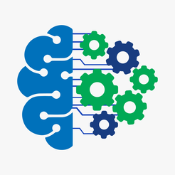

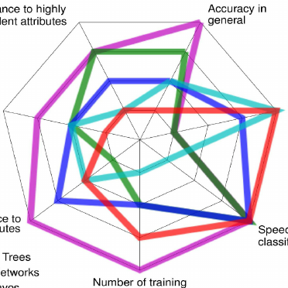
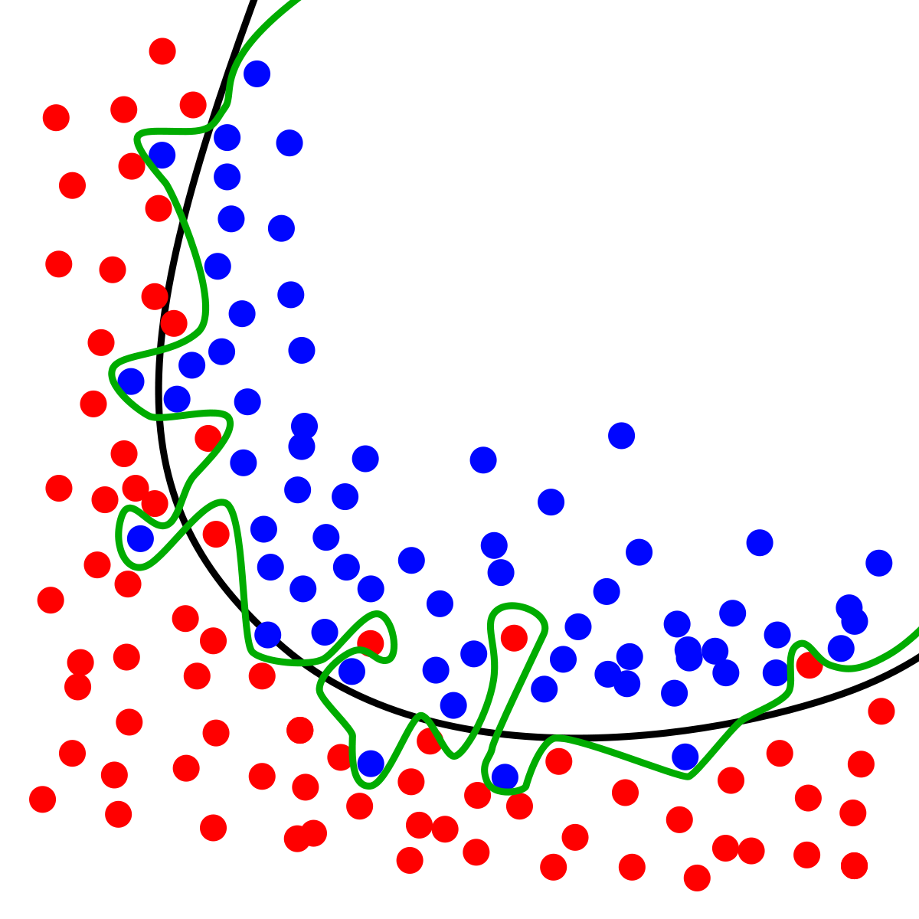
Model training
Try more than one machine learning technique.
Fine-tune parameters.
Assess model performance.
Avoid Over-fitting.

Slide 10
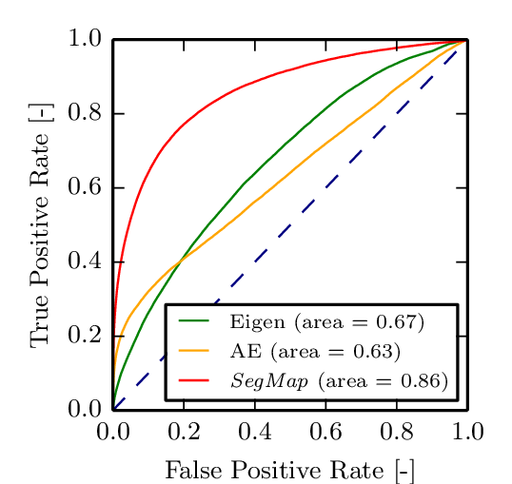
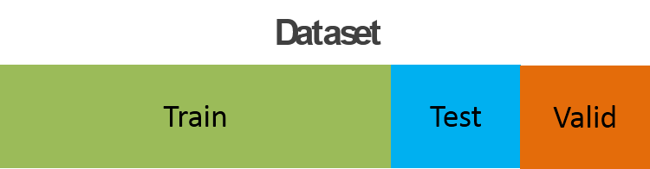
Model Evaluation
MODEL SELECTION
ASSESSMENT
PRESENTATION
Law of Parsimony
Execution time
Deployment complexity

Slide 11
Model Deployment
Model production cycle
Scoring code, or publish model as a web service
Model Documentation (Technical Specifications)
Reproducibility
Model Persistence vs. Model Transience

Slide 12
Model Tracking
MONITOR
MAINTAIN
TEST
Model performance over time
Predictor distribution
Model maintenance plan
Adding new data sources
Version control
Experimental Design (A/B tests, Fractional Factorial)

Slide 13
Data Science Process: Recap
Business Understanding | Data Preparation | Data Munging | Model Training | Model Evaluation | Model Deployment | Model Tracking
Determine
Understand
Map
Evaluate
Peer Review
Present
Deploy
Document
Identify
Impute
Train
Monitor
Collect
Transform
Assess
Maintain
Assess
Reduce
Select
Test
Vectorize
DISCUSS COLLATE WRANGLE PERFORM COMMUNICATE EXECUTE TRACK

